Slide 1





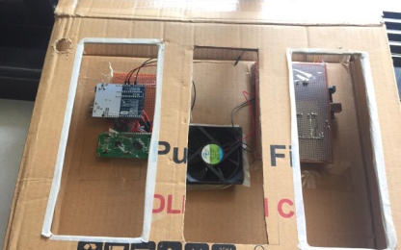
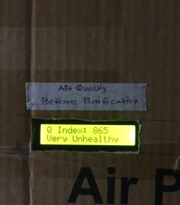
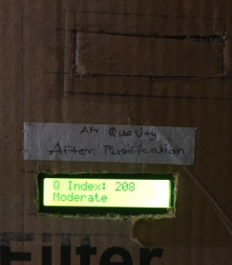
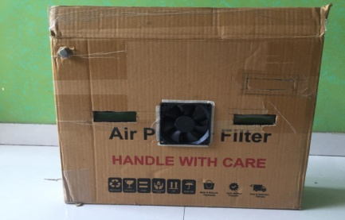
Department : Electronics and Telecommunication
Project Title : Solar Powered Portable Air Purifier
Domain (Area of Project) : Electronics and embedded
Name of Project Guide : Prof. Hemant Jadhav (hemant.jadhav@vit.edu.in)
Name of Students : Pooja Chavan (pooja.chavan@vit.edu.in)
Pranali Bhujbal (pranali.bhujbal@vit.edu.in)
Anoushka Hazari (anoushka.hazari@vit.edu.in)
Shrikant Raut (shrikant.raut@vit.edu.in)
Brief idea of Project :
Solar Powered Portable Air Purifier is about designing an air purifier system which is powered by solar energy and testing the effectiveness of the system to curb the air pollution. The focus is on extracting the suspended particulate matter from the air which are the major contributors in the pollution of air in many urban cities. It works on a non-conventional method and intents to achieve best possible air purification results using eco-friendly and economical method.
Screenshots of the Project / Photos of Working Model (Min.3):
Applications:
Some major applications for air purifiers include removal of dust, toxic fumes, volatile organic matter, oil mist, and harmful odours to enhance the performance of production machines as well as industrial occupants working in high precision environment.
Awards/Participation if Any for TPP / Competitions / Paper Publication / Any Other Pls. Specify: --
Manuscript is ready. Waiting for publishing in the reputed journal/conference.
Notes:
DO NOT CHANGE ANY FONT TYPE AND SIZE ANYWHERE IN THE SLIDE.
Put Group ID in right bottom corner

